Slide 1


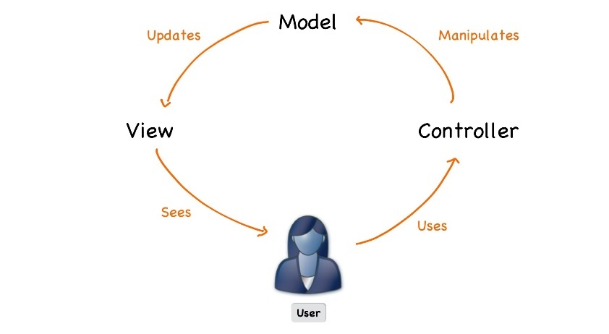



C# Web Development Basics
Course Overview
Web Development Basics
SoftUni Team
Technical Trainers
Software University
http://softuni.bg

Slide 2








Table of Contents

Slide 3
Have a Question?
sli.do #CSharp-Web

Slide 4







SoftUni Diamond Partners

Slide 5




C# Web Development Basics
Course Objectives & Program

Slide 6
Course Objectives
The C# Web basics course provides
Basic knowledge over HTML and CSS
Fundamental knowledge over what is HTTP and how it works
Fundamental knowledge over what is a web server and what work it serves and how
Fundamental knowledge over the MVC pattern and it’s appliance in Web applications

Slide 7

The Trainers Team

Slide 8

Trainers Team
Ivaylo Kenov
Various job titles at the same time:
Mathematical competitions champion
Full Stack Technical Trainer
Senior Software Developer
Solutions Architect & Technical Lead
One-man army @ https://MyTestedASP.NET
Contacts
https://github.com/ivaylokenov
https://facebook.com/ivaylo.kenov
https://linkedin.com/in/kenov

Slide 9

Evaluation

Slide 10


Scoring System for the Course
Mandatory:
Final exam – 90%
Homework submissions – 10%
Bonuses:
Presence in class – 5% bonus
Forum activity – bonus up to 5%

Slide 11

The Final Exam
Solving simple HTML & CSS problems
Web application using the custom made web server with it’s implemented MVC architecture

Slide 12










Resources
What We Need Additionally?

Slide 13



C# Course Web Site, Forum and FB Group
Official web site:
Official discussion forum:
Official Facebook groups:
https://softuni.bg/courses/csharp-web-development-basics
https://softuni.bg/forum/categories/66/csharp-web-development-basics
https://www.facebook.com/groups/csharpweb/

Slide 14

The C# Web Dev Basics Slides and Videos
All lecture slides, videos, homework assignments, projects and other resources are open content, available for free
Visit the course web site to access the course resources

Slide 15


C# Recommended Software
Software needed for this course:
Microsoft Windows 10
Visual Studio 2017 – https://www.visualstudio.com
MS SQL Server - https://www.microsoft.com/en-cy/sql-server/sql-server-downloads

Slide 16



Learn to Search in Internet
The course assignments require to search in Internet
This is an important part of the learning process
Some exercises intentionally have no hints
Learn to find solutions!
Software development includes everyday searching and learning
No excuses, just learn to study!
Developers learn new technologies, tools, languages every day!

Slide 17
C# Web Development Basics – Course Overview
https://softuni.bg/courses/csharp-web-development-basics

Slide 18
License
This course (slides, examples, demos, videos, homework, etc.) is licensed under the "Creative Commons Attribution-NonCommercial-ShareAlike 4.0 International" license

Slide 19





Trainings @ Software University (SoftUni)
Software University – High-Quality Education, Profession and Job for Software Developers
softuni.bg
Software University Foundation
http://softuni.foundation/
Software University @ Facebook
facebook.com/SoftwareUniversity
Software University Forums
forum.softuni.bg

